Slide 1
VESTING Board 2024 - 2025
Information Meeting

Slide 2
A year in the VESTING Board
What can you expect?

Slide 3
VESTING Board
Responsible for the day to day operations (activities, committees, finances, promotion…)
Representing VESTING at companies, the faculty and other associations
Own policy and policy points
Fun, valuable lessons and experiences

Slide 4
What makes a board year unique?

Slide 5
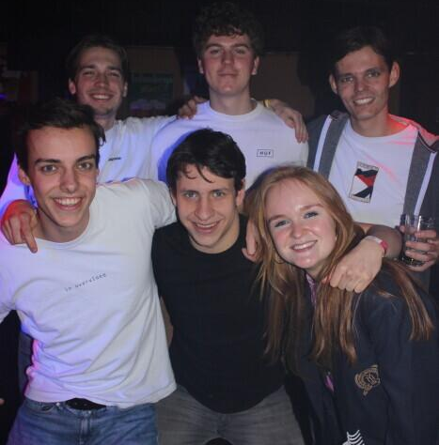
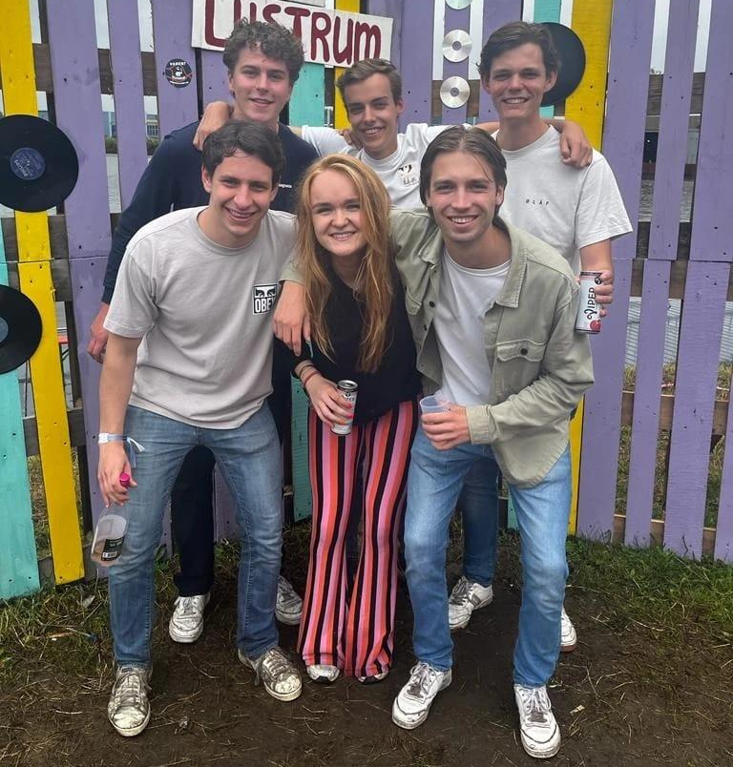
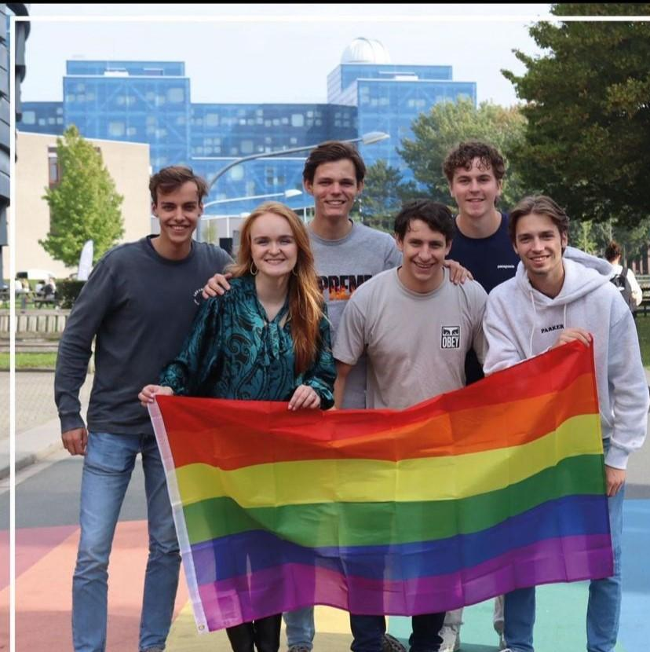
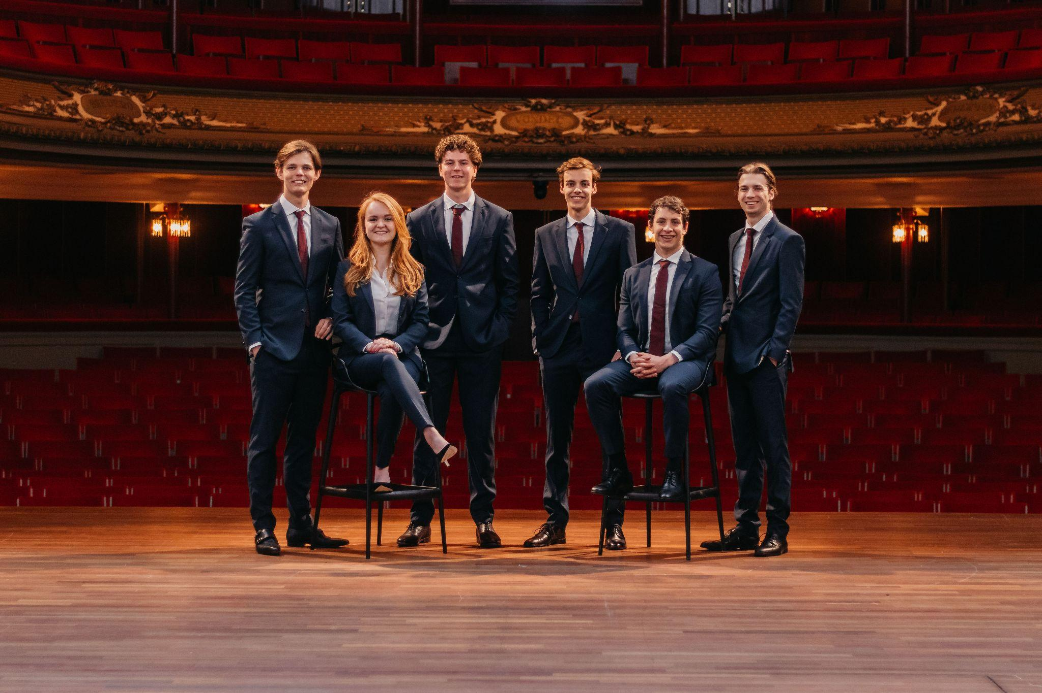
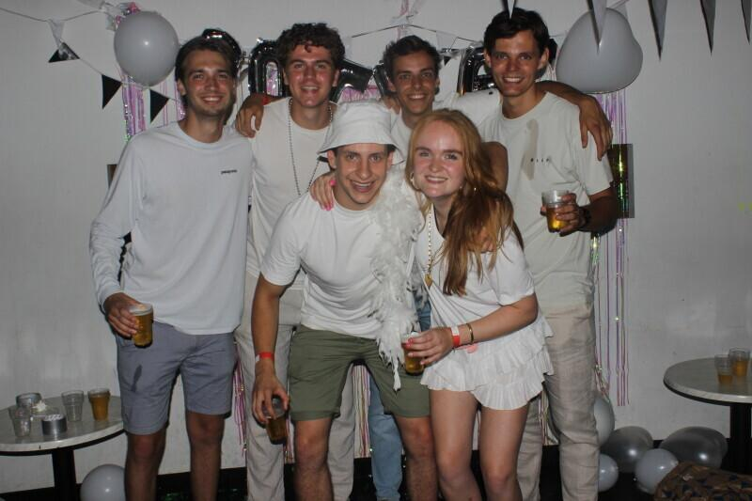

Slide 6
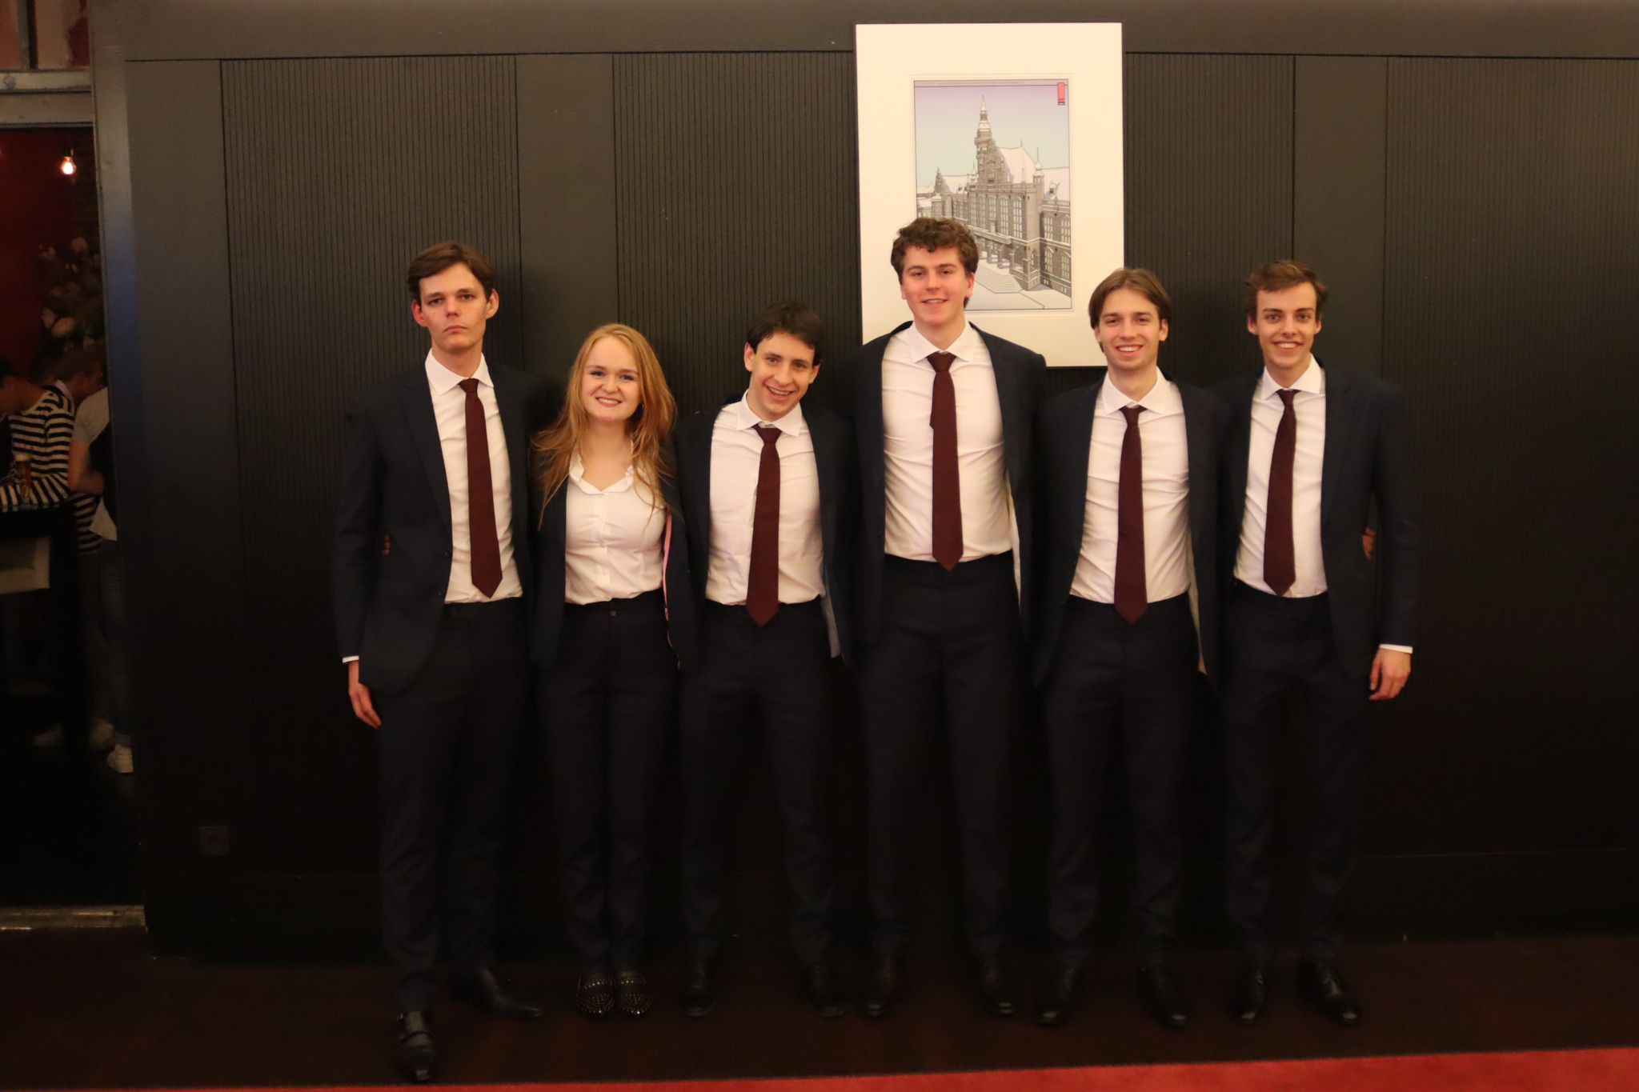
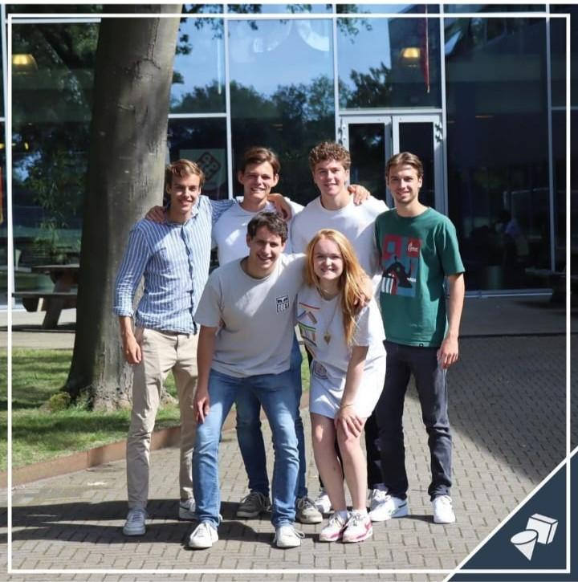
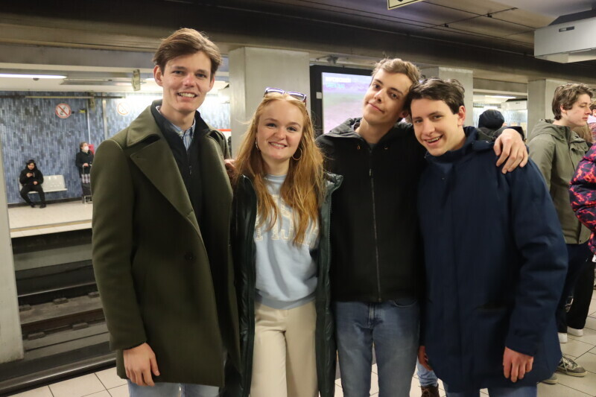
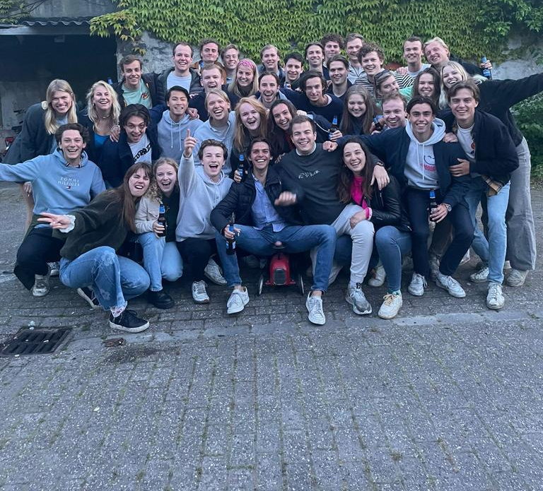

Slide 7
General information
An average of 30 hours per week
General board tasks plus function-specific and divisible tasks
Many fun (constitution) drinks, activities and board days
1 to 2 courses per quarter
Board grant

Slide 8
Chairman
Leading the board
Chairing board meetings
Overview all tasks
Strategic policy (together with vice chairman)
General policy of the association
Execution of the policy
Peaks: (H)ALV

Slide 9
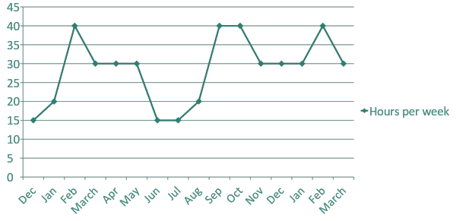
Chairman

Slide 10
Chairman
Contact with external parties:
Study programme EOR(AS) and departments
The Interim (EBF, FSG, MARUG & TeMa)
Supervisory Board (RvC)
The LOES (VSAE, Kraket, FAECTOR, Vectum & Asset)
University Council (e.g. SOG & Calimero)
Expedition Strategy door deel te nemen in de Raad van Toezicht;

Slide 11
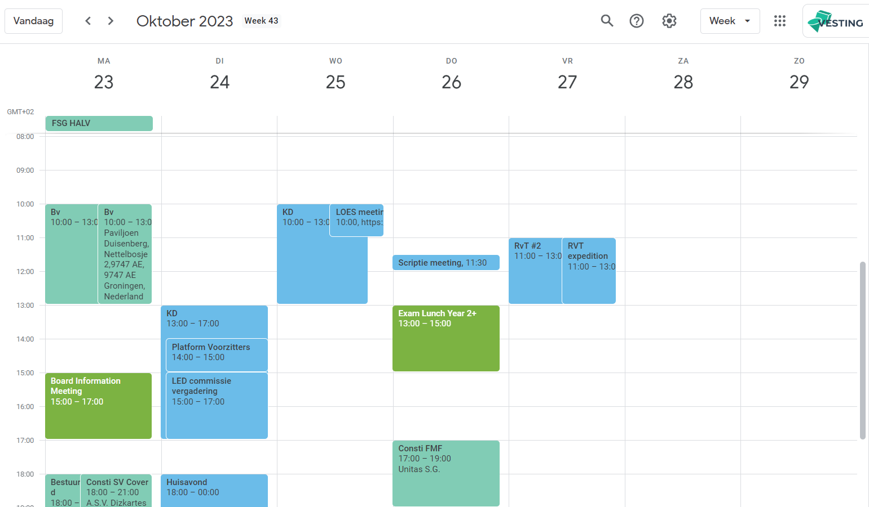

Slide 12
Chairmanship: something for you?
Character traits
Decisive
Keeping track of the progress
Strategic insight
Interested in…
Strategic policy
Leadership
Representing VESTING towards external parties

Slide 13
Huidige structuur
Intern Coördinator
● Interne communicatie;
● Commissiesollicitaties;
●Coördinator Activity Committee (AC);
● Coördinator Career Experience Committee (CEC);
● Coordinator European Programme Committee (EPC):
● Coördinator Freshmen Symposium Committee (FSC);
● Coördinator Introduction Weekend Committee (IWC);
● Coördinator Masterteam;
● Coördinator Sports Committee (SC);
● Coördinator Weekend Trip Committee (WTC);
● Voorzitter Magazine Committee (MC) en technisch beheer ‘De Econometrist’.
Public Relations Coördinator
● Uitwerken en handhaven promotiebeleid;
● Ontwikkeling promotiemateriaal;
● Coördinator promotiekanalen;
● Begeleiden Marketing Officers van commissies;
● Coördinator Multimedia Committee (MMC);

Slide 14
Nieuwe structuur
Intern Coördinator;
● Interne communicatie;
● Commissiesollicitaties;
●Coördinator Activity Committee (AC);
● Coördinator Introduction Weekend Committee (IWC);
● Coördinator Masterteam;
● Coördinator Sports Committee (SC);
● Coördinator Weekend Trip Committee (WTC);
● Uitwerken en handhaven promotiebeleid;
● Coördinator promotiekanalen;
● Begeleiden Marketing Officers van commissies;
● Coördinator Multimedia Committee (MMC);
● Ontwikkeling promotiemateriaal.
Vice Chairman;
● Ontwikkelen beleid (als vicevoorzitter);
● Het onderhouden van contact met De Economische en Bedrijfskundige Faculteitsvereniging (EBF) (als vicevoorzitter);
● Green officer
● Coördinator Bedrijfscontacten II;
● Coordinator European Programme Committee (EPC)
● Coördinator Career Experience Committee (CEC);
● Coördinator Conference Committee (CC);
● Coördinator Freshmen Symposium Committee (FSC).

Slide 15
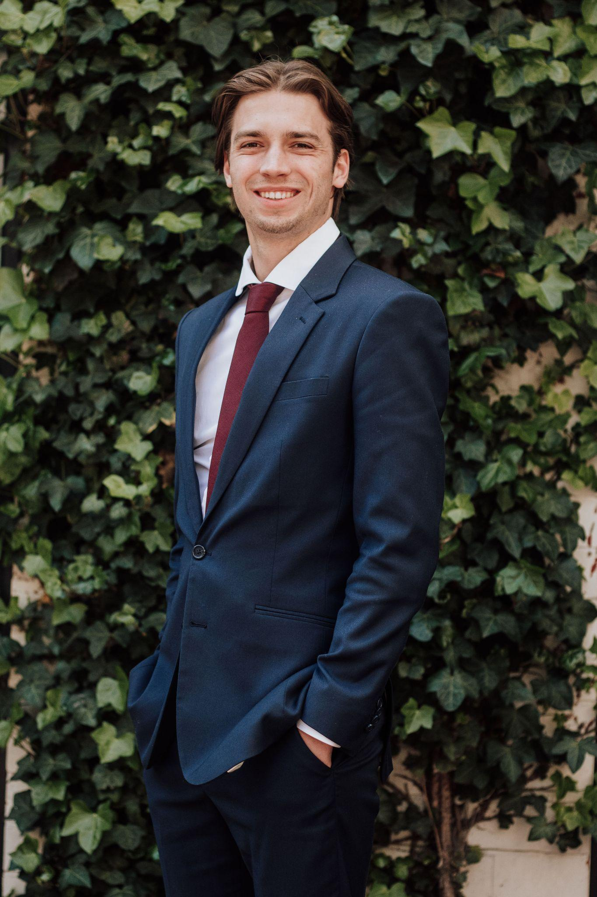
Vice Chairman
Ivo Roest

Slide 16
Vice Chairman
Support of the strategic policy
Contact Economics and Business Faculty Association (EBF)
Interests
General policy (association broad)
Strategic thinking

Slide 17
Vice Chairman
● Ontwikkelen beleid (als vicevoorzitter);
● Het onderhouden van contact met De Economische en Bedrijfskundige Faculteitsvereniging (EBF) (als vicevoorzitter);
● Green officer
● Coördinator Bedrijfscontacten II;
● Coordinator European Programme Committee (EPC)
● Coördinator Career Experience Committee (CEC);
● Coördinator Conference Committee (CC);
● Coördinator Freshmen Symposium Committee (FSC).

Slide 18
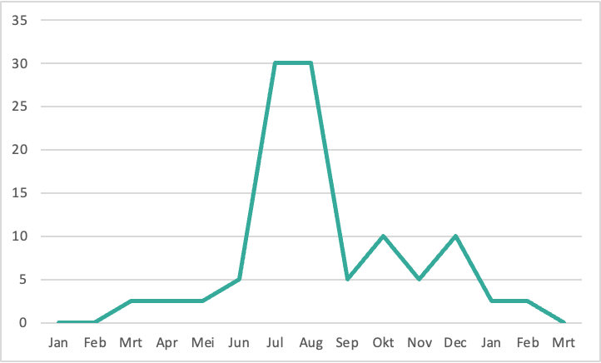
External Affairs II

Slide 19
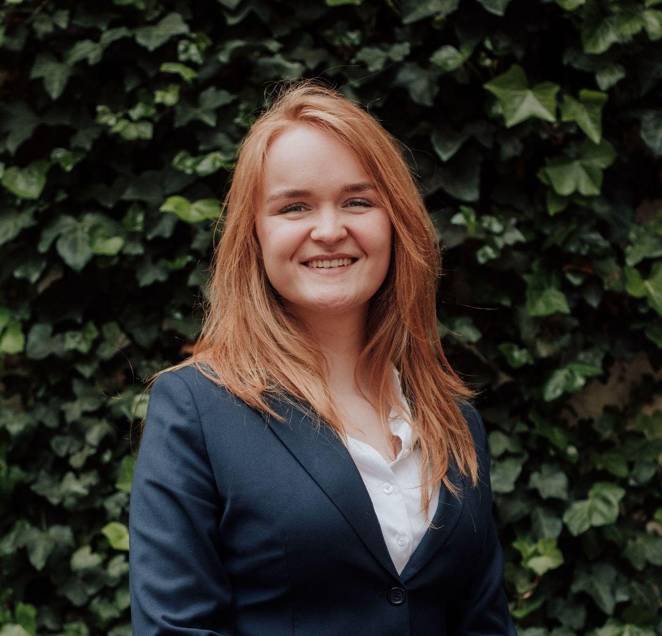
Treasurer
Roos Speel

Slide 20
Financial tasks
Financial policy
Financial management
Send and pay invoices
Direct debits
Bookkeeping
Settle financial business

Slide 21
Other tasks
Coordinator Conference Committee
Coordinator of LED Board 2024
Treasurer LOES 2023-2024
Fifty Cent Shop
Permanent task treasurer
VESTING Shop
Permanent task treasurer

Slide 22
Collaboration
KasCo
Treasurers other committees
Treasurers other boards
LOES

Slide 23
Interests/characteristics
Reliable
Exact
Working independently
Patient
Decisive
Bookkeeping

Slide 24
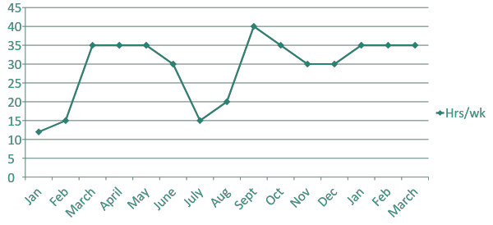
Treasurer

Slide 25
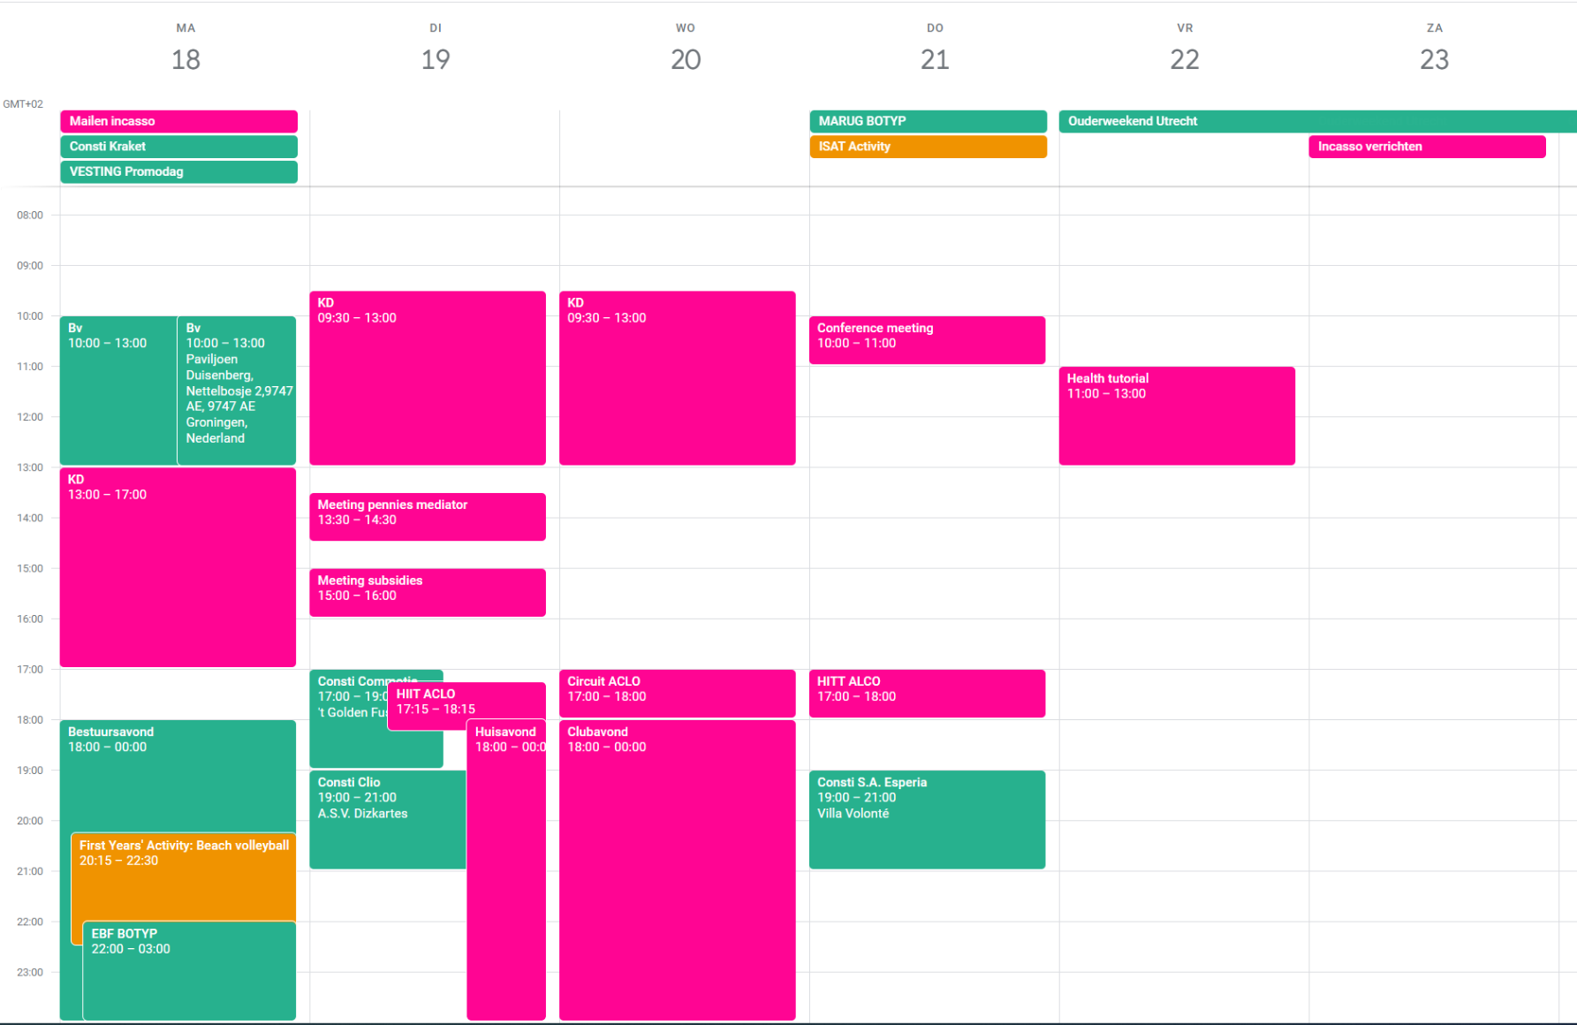

Slide 26
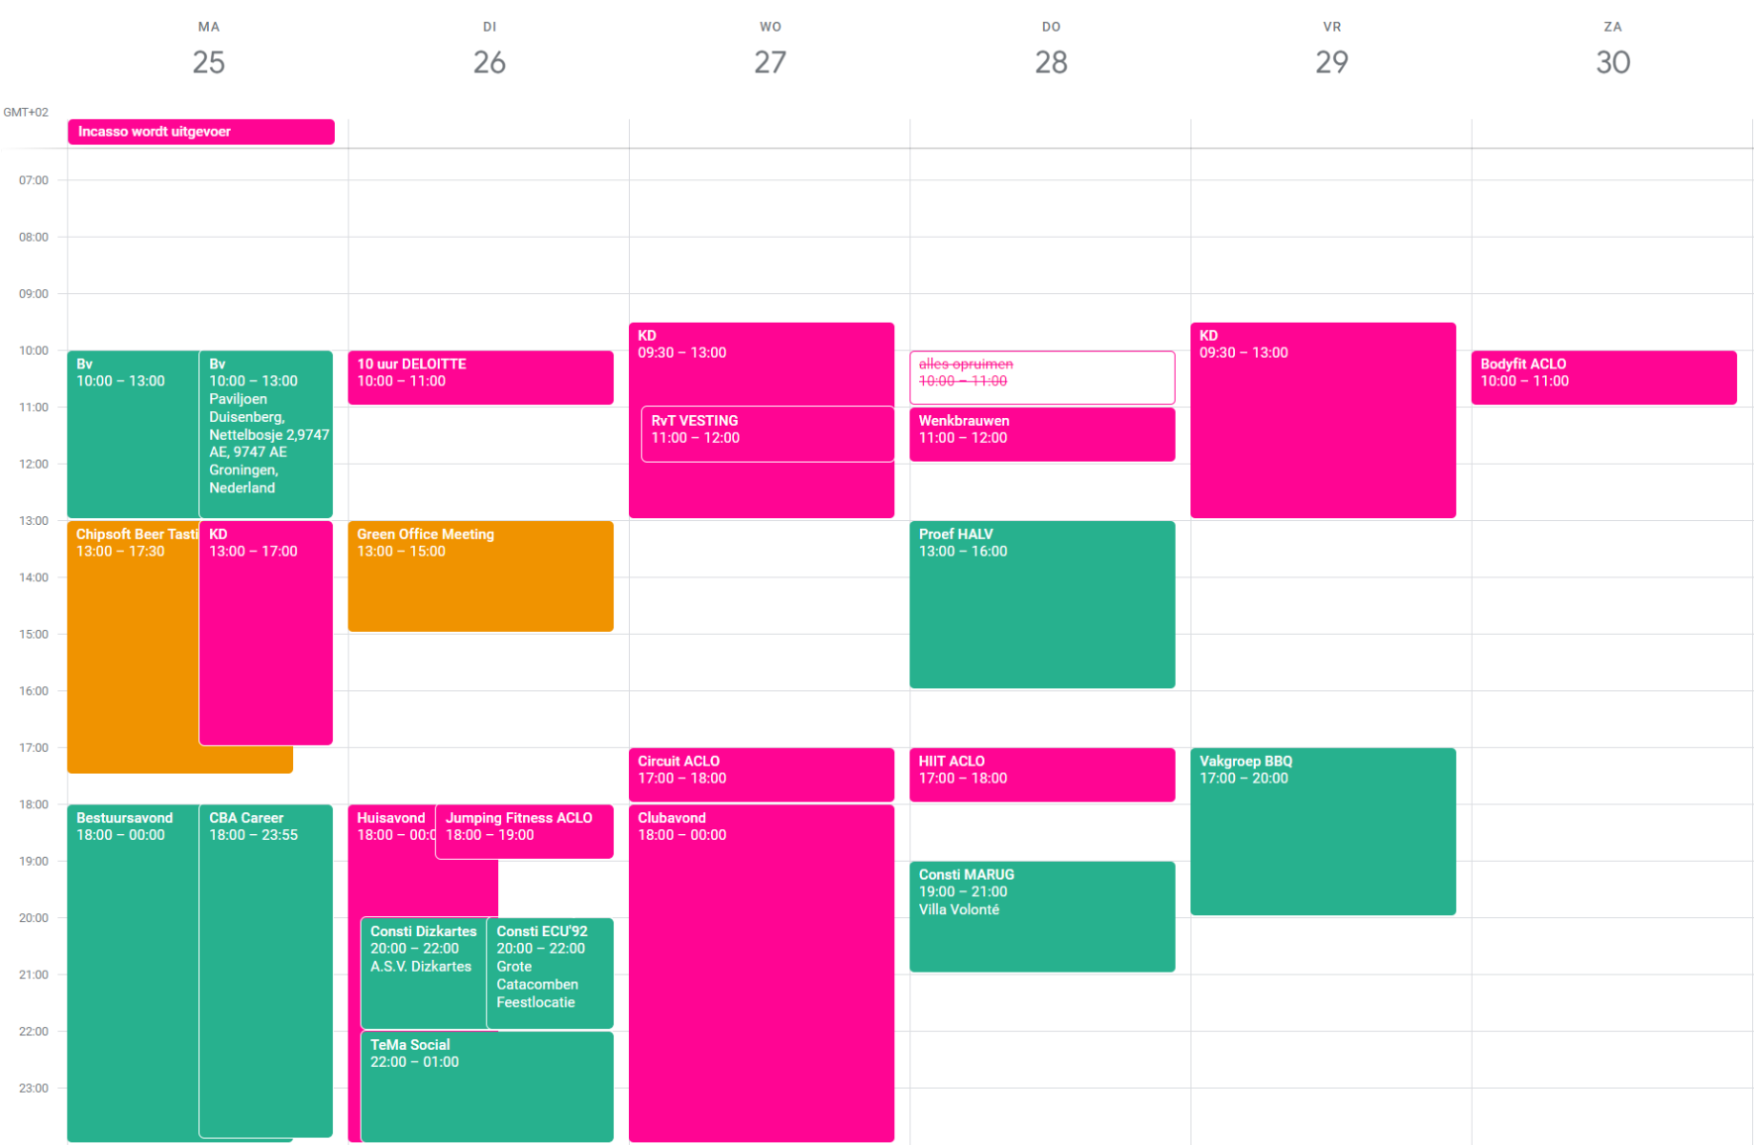

Slide 27
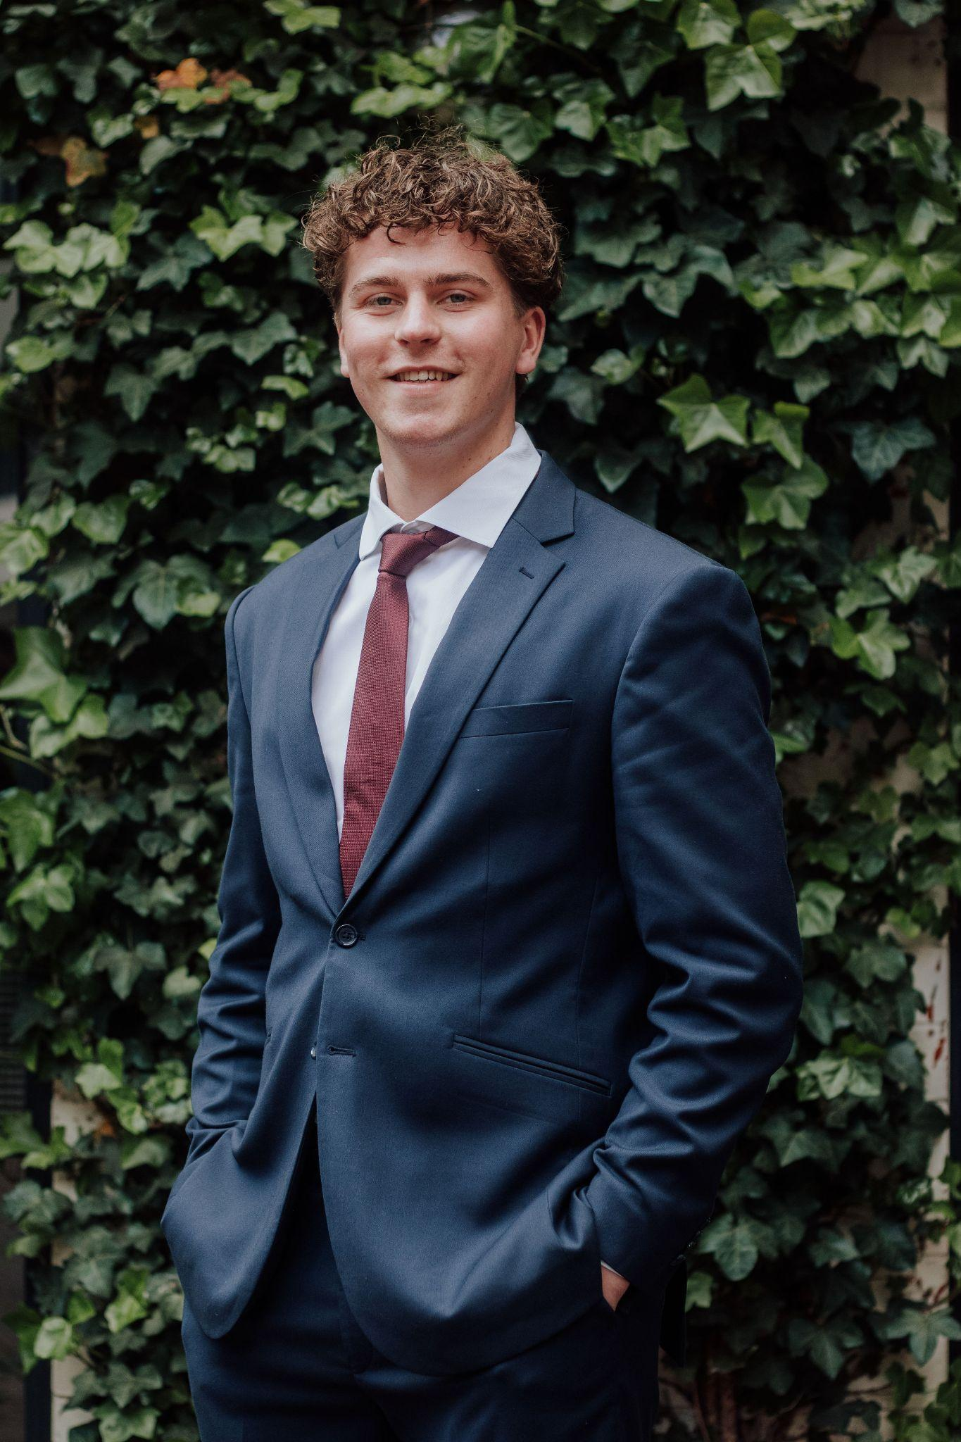
Secretary
Jochum Popkema

Slide 28
Secretary
Diverse tasks
Set and divisible tasks
Space to pick up different projects
Characteristics:
Precise
Eager to help
Able to keep the overview (organised)

Slide 29
Set tasks
Keeping minutes during Board meetings
Newsletters
Mastering VESTING Website
Correspondence and email
Booksale
Membership administration
Facilities VESTING Room (VK)
Year planning
Archives

Slide 30
Divisible tasks
External affairs ll
Archiving
Informal Activities and Socials

Slide 31
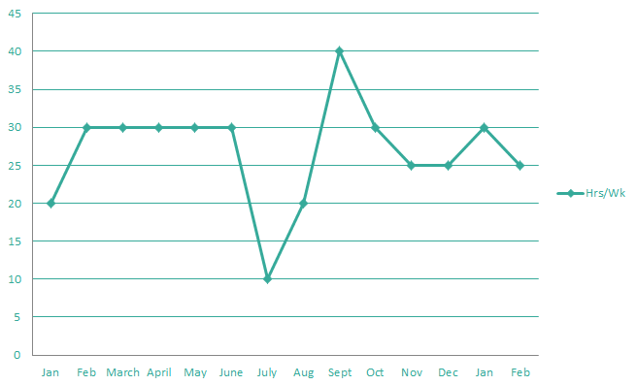
Secretary

Slide 32
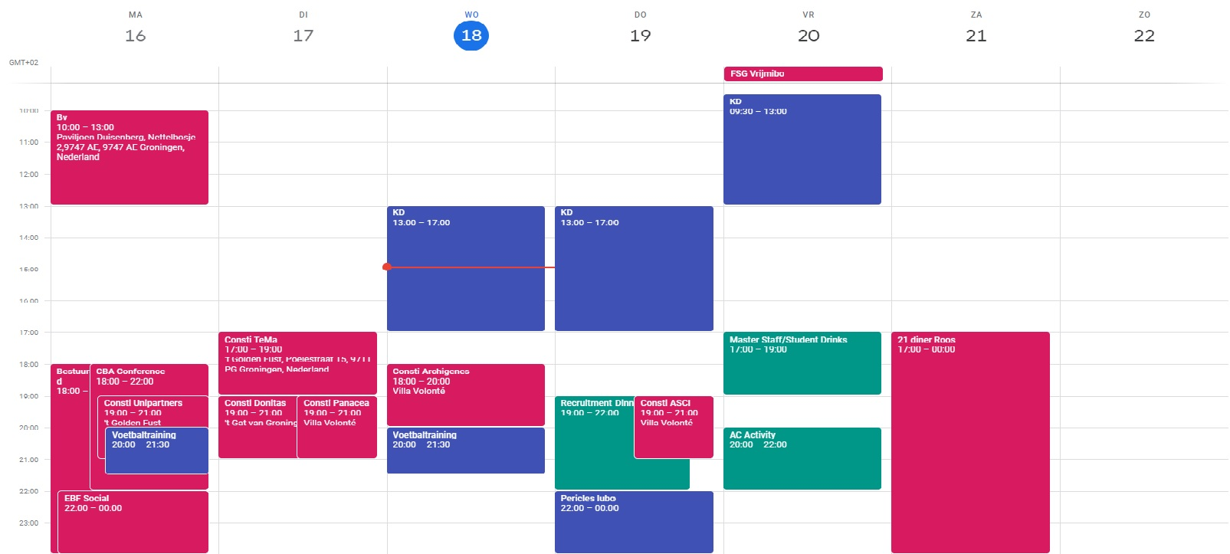

Slide 33
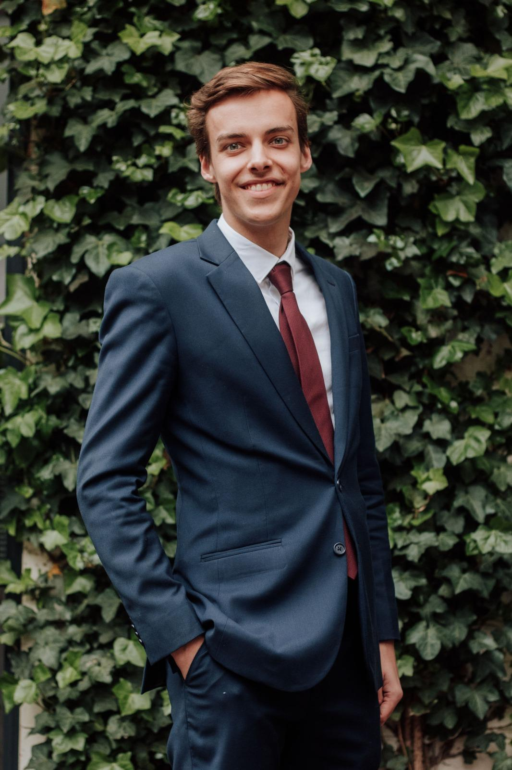
Internal Affairs
Joep Nieuwenburg

Slide 34
Internal Affairs
Various function, link between committee members and the board
Characteristics:
Patient
Approachable
Critical
Knowledge of people
Flexible

Slide 35
Tasks
Internal communication
Committee Applications
Coordinating VESTING Committees

Slide 36
Divisible tasks
Chairman Magazine Committee
Coordinator Masterteam

Slide 37
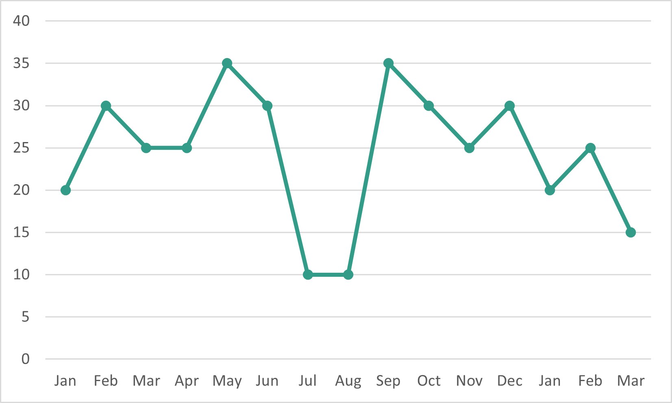
Time Management

Slide 38
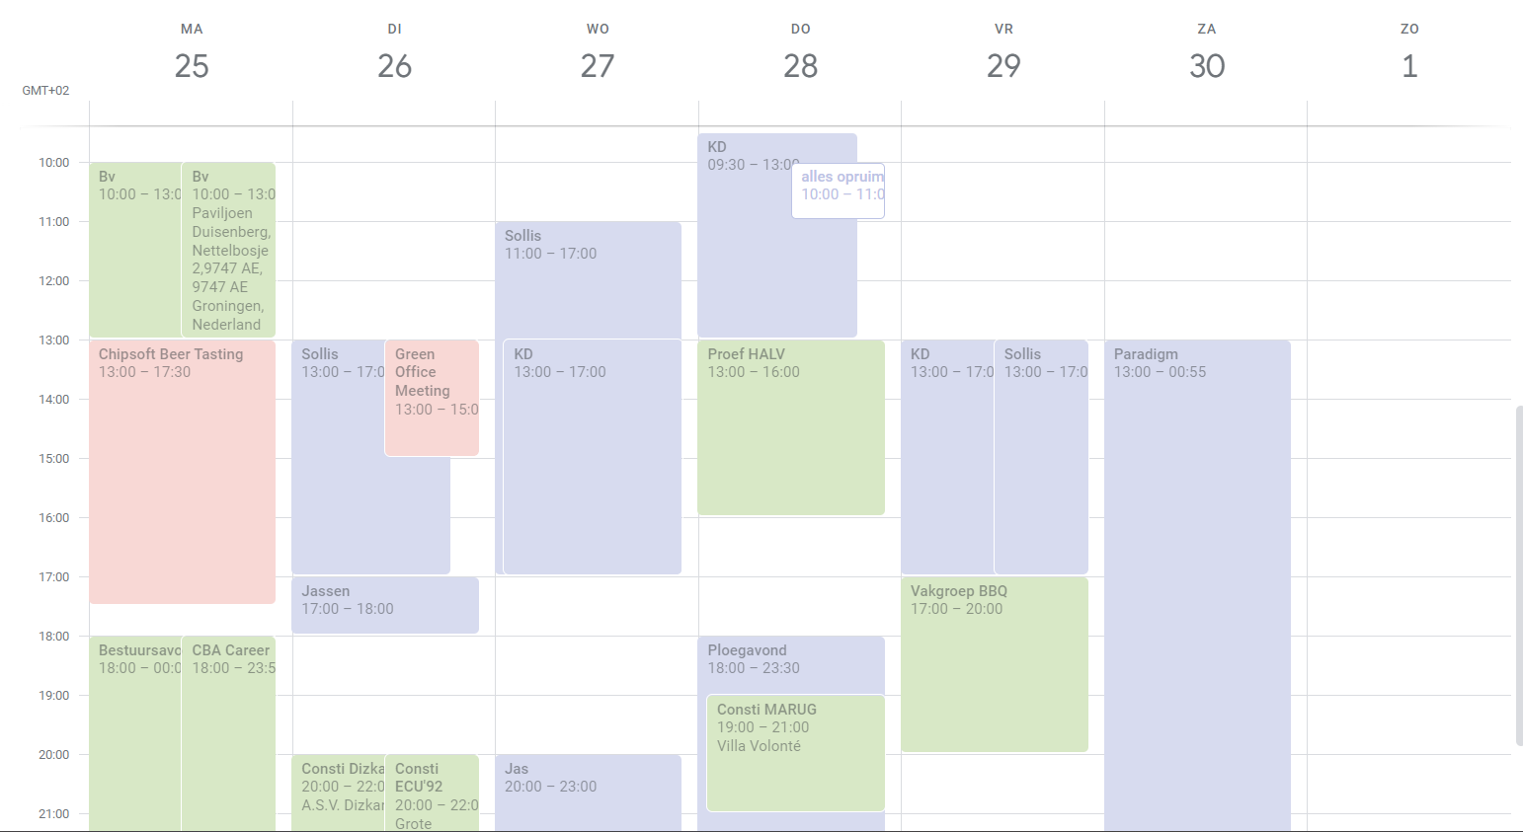

Slide 39
Public Relations
Diverse function, responsible for social media and all promotion material
Characteristics
Creative
Eye for detail
Orderly

Slide 40
Tasks
Main tasks:
Developing promotion material for VESTING Events
Manage all VESTING Social Media
Coordinating the Marketing Officers
Other tasks:
Coordinator Multimedia Committee

Slide 41
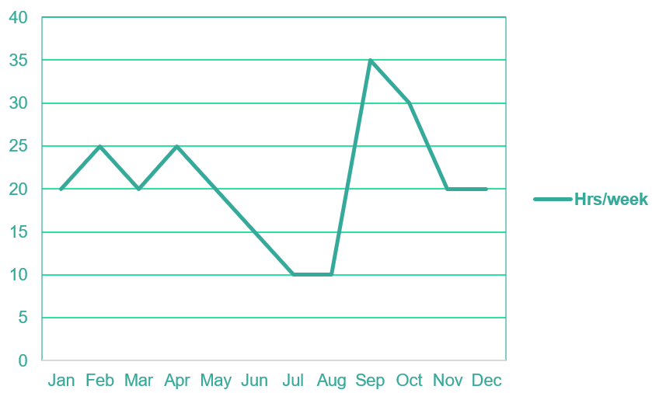
Public Relations

Slide 42
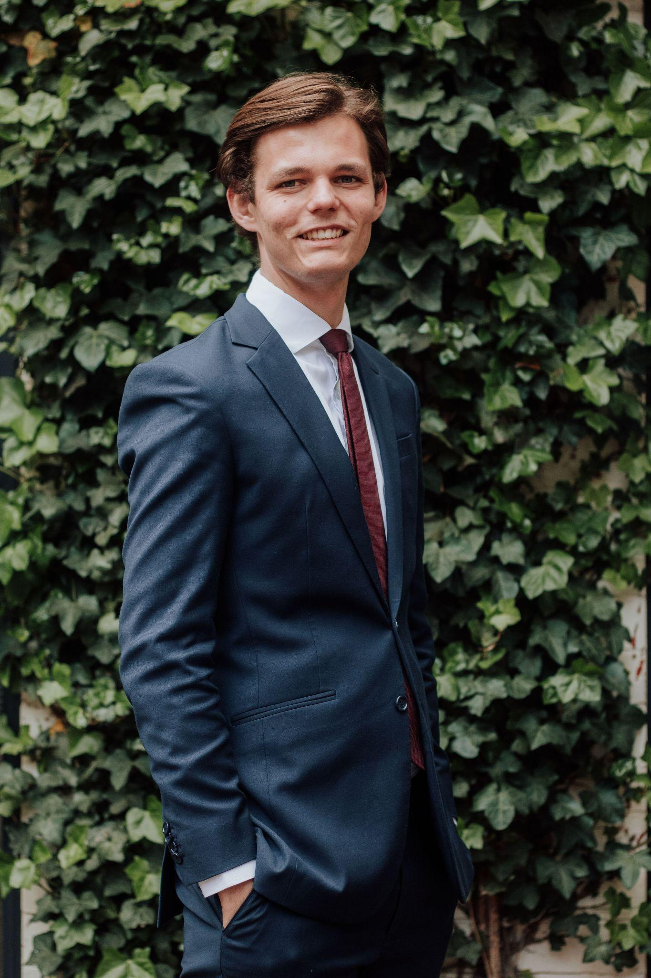
External Affairs
Coordinator
Robbin Muntz

Slide 43
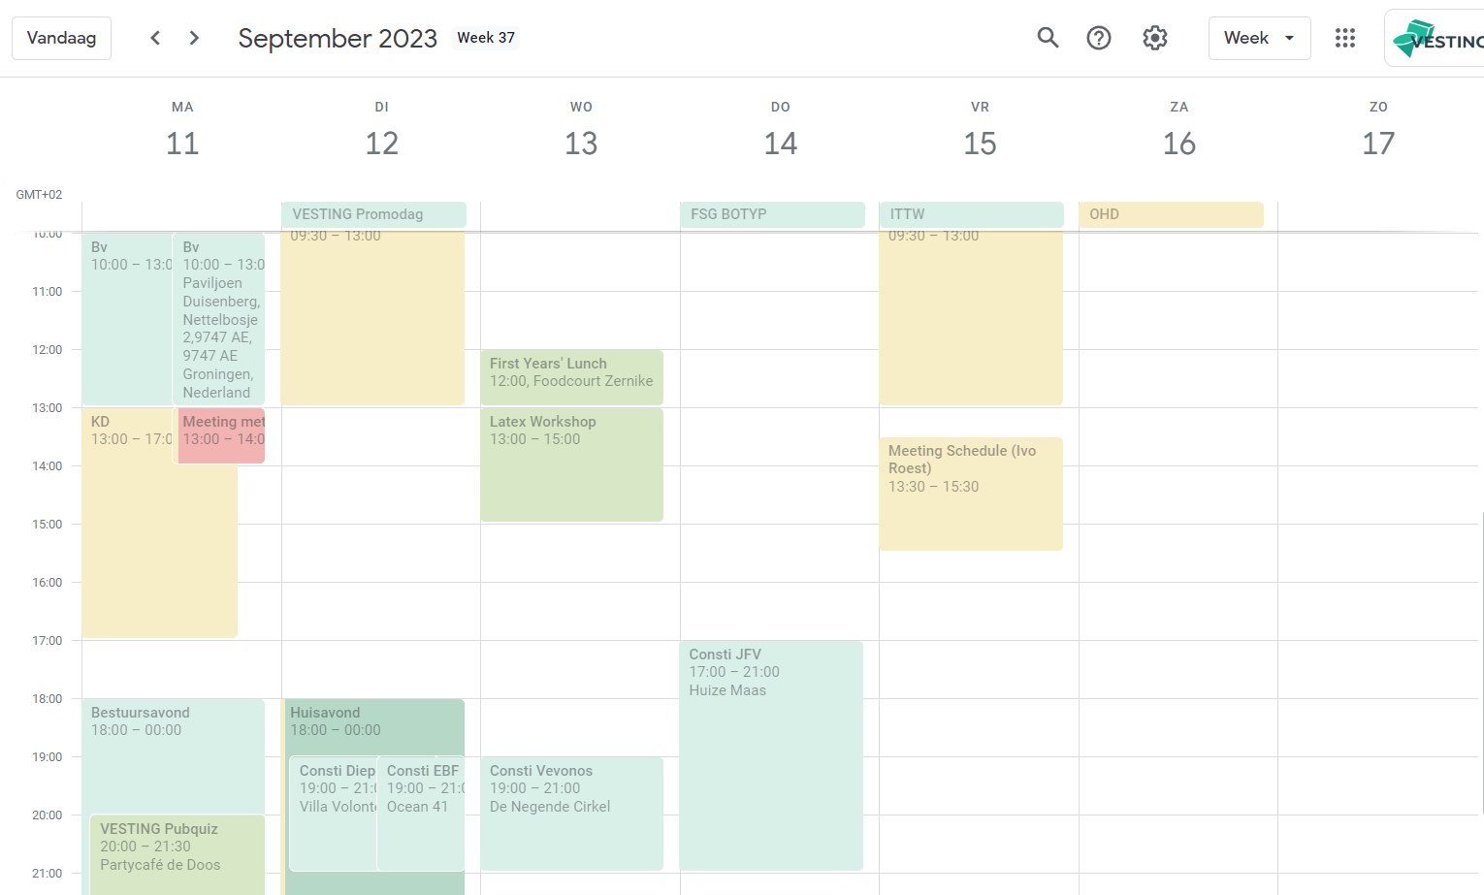

Slide 44
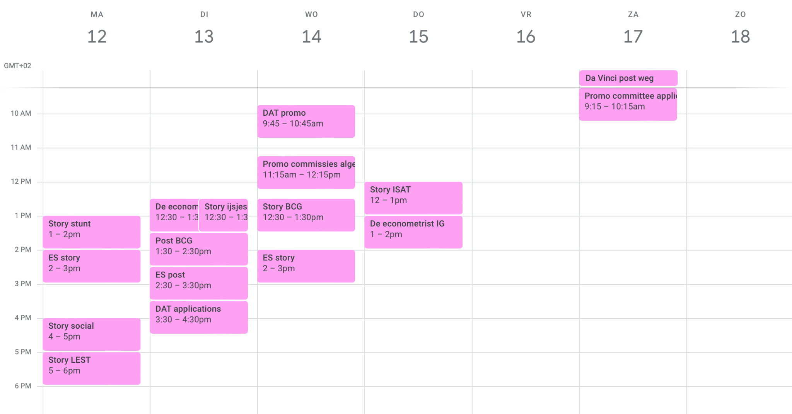

Slide 45
External Affairs
Coordinating commercial relations and career affairs
Main tasks:
Acquisition;
Bridge between students and companies;
Organising formal activities (Data Science Tour, Trading Tour, Recruitment Dinners etc.).

Slide 46
Acquisition
Think about what you want to “sell”
Discuss with old externals and board members;
Make your brochure.
Summer meetings
Meetings with around 80 companies;
Physical and online;
Partners and new companies.
Rounding up
What company at which event;
Partnerships;
Online Exposure.
“Cold” Acquisition
New companies;
Throughout the whole year.

Slide 47
Other tasks
Company promotion with PR (website/mailings/social media)
Coordinator and Acquisition Data Analytics Team
Coordinator and Acquisition Groningen Investment Team Delta
Supervising the externals of executive committees of VESTING (CC, CE, IPC, etc.);
Organising alumni activities;
Contact with VESTING Alumni;
Characteristics: - Communicative / social; - Professional / representative; - Strategic insight.

Slide 48
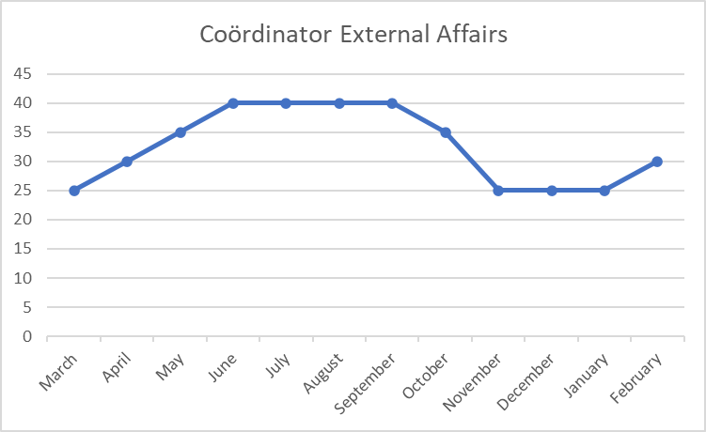

Slide 49
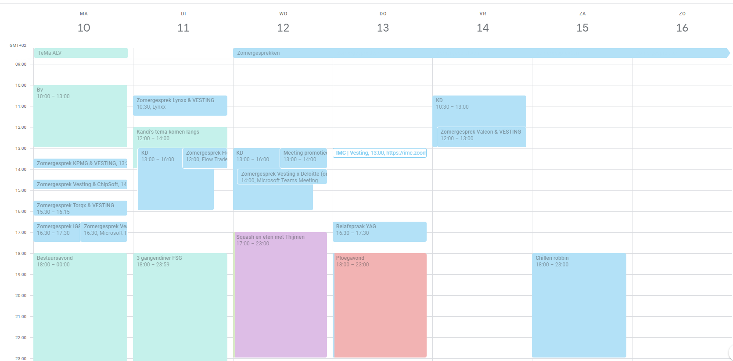

Slide 50
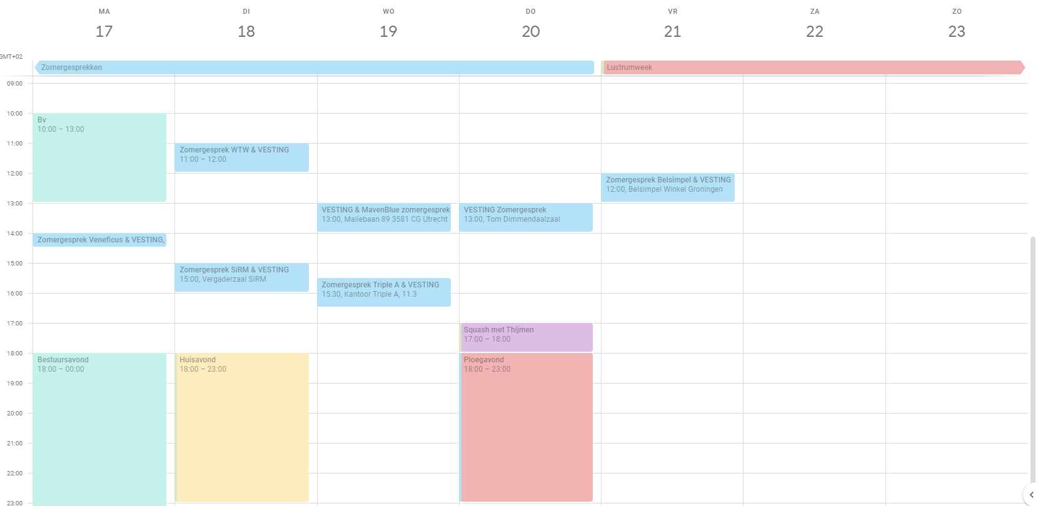

Slide 51
Why VESTING Board?
A board year is not only very fun, but also:
Companies value it, it looks very good on your cv
Developing organizational and social skills
Responsible of a professional association with a budget of more than €130.000
Experiences and memories that will last a lifetime
Networking (other boards, companies, education)
A unique opportunity!

Slide 52
Interested?
Ask one or several of us all of your questions!
Committee experience is not required
Starting year is not determinative
Deadline chairman: 13 November
Deadline other functions: 12 December

Slide 53
Questions?

